Slide 1
The relational model
INF08104: Database Systems
Brian Davison, 2014/15

Slide 2
Agenda
Sets and relations
Keys and entity integrity
Keys and relationships

Slide 3
Data model components
Component | Description | Examples
Entities | The important things in the real world that need to be modelled | People, places, objects, events, etc.
Attributes | Individual items of data associated with an entity | Name, national insurance number, weight, date of manufacture
Relationships | Ways in which entities are connected | A is part of B, A lives in B, A produces B, A takes place in B, etc.
Constraints | Rules which place limits on the data that is allowed | Every A must have a B, Only future dates are allowed, etc.

Slide 4

Entities and relationships
This is a relation – also known as a table
This is a relationship – not a relation
name | phone | gender | date of Birth | course
Andrew | 07865124635 | M | 1-MAR-1991 | BEng Comp
Barney | 07625986774 | M | 16-APR-1990 | BIS
Carole | 07822101568 | F | 27-NOV-1991 | BEng Comp
Dorothy | 07764662553 | F | 12-SEP-1991 | S&F

Slide 5
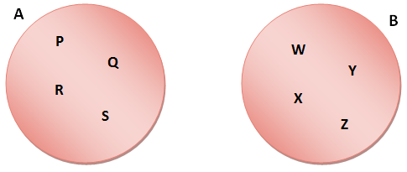
Two sets
A ( P, Q, R, S )
B ( W, X, Y, Z )

Slide 6
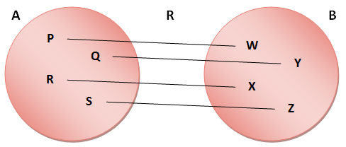
A mathematical relation
R = ( (P, W), (Q, Y), (R, X), (S, Z) )

Slide 7
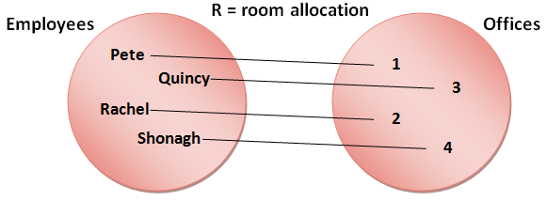
A realistic example
Room allocation = ( (Pete, 1), (Quincy, 3),
(Rachel, 2), (Shonagh, 4) )

Slide 8
From relations to tables
name | office
Pete | 1
Quincy | 3
Rachel | 2
Shonagh | 4

Slide 9
Domains
The set of possible values for a column
All values have the same datatype
Date
Variable length character string (varchar)
Integer (eg -2, -1, 0, 1, 2, 3...)
Floating point number (Float – eg 1.23, 12035.65246371, etc.)
Datatype defines an infinite set of values
Domain defines a more restricted set
Domain may be implemented by constraints in the database

Slide 10
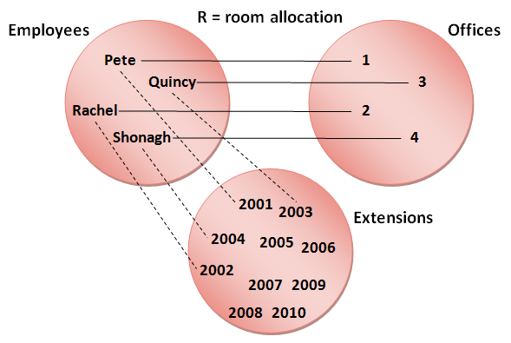
The degree of a relation

Slide 11
The degree of a table
Employees
(4)
Offices
(4)
Extensions
(10)
name | office | extension
Pete | 1 | 2001
Quincy | 3 | 2003
Rachel | 2 | 2002
Shonagh | 4 | 2004

Slide 12
Keys and entity integrity
Entity integrity: the ability to uniquely identify one row in a table
Key: an attribute (or group or attributes) that differentiates the rows
eg matriculation number, country symbols (UK, FR, CN, etc)
Key determines the other values; other values are functionally dependent on the key
What makes a good key
Unique
Doesn’t change
name | office | extension
Pete | 1 | 2001
Quincy | 3 | 2003
Rachel | 2 | 2002
Shonagh | 4 | 2004
Pete | 4 | 2004
name | office | extension
Pete | 1 | 2001
Quincy | 3 | 2003
Rachel | 2 | 2002
Shonagh | 4 | 2004

Slide 13
Choosing a key
first_name | last_name | date_of_birth | ni_number | office | extension
Pete | Brown | 16/4/1964 | 12435 B6934C | 1 | 2001
Quincy | Green | 12/11/1974 | 23412 D6274C | 3 | 2003
Rachel | White | 15/2/1985 | 34253 F6351B | 2 | 2002
Shonagh | Brown | 20/7/1969 | 23415 K3652A | 4 | 2004
Pete | Black | 12/11/1974 | 31243 W2784D | 4 | 2004
ni_number
ni_number, last_name
date_of_birth, office, first_name
first_name, last_name, date_of_birth
first_name, last_name, date_of_birth, extension

Slide 14
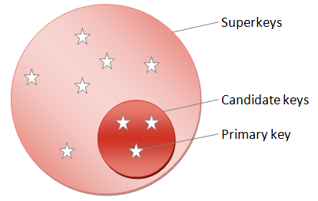
Types of key
Superkey
Uniquely identifies a row
Candidate key
Uniquely identifies a row and contains no redundant attributes
Primary key
Selected candidate key

Slide 15
Relationships and cardinality
STUDENT
*
enrols_on
1
PROGRAMME
staff
1
leads
1
PROGRAMME
STUDENT
*
studies
*
module

Slide 16
Optionality
staff
1..1
leads
0..1
PROGRAMME
Optional 
One member of staff leads zero or one programmes
Mandatory
One programme is led by one and only one member of staff
Cardinality & Optionality = Multiplicity

Slide 17
